Slide 1
Intelligent cloud
Bianca Furtuna
Technical Evangelist
@Fur_Bi

Slide 2
Intelligent ?
human-like
smart
good with numbers

Slide 3
Intelligence
“The ability to acquire and apply knowledge and skills”*
Context/Environment understanding
Interaction with environment
learn
do
* Online Oxford Dictionary

Slide 4
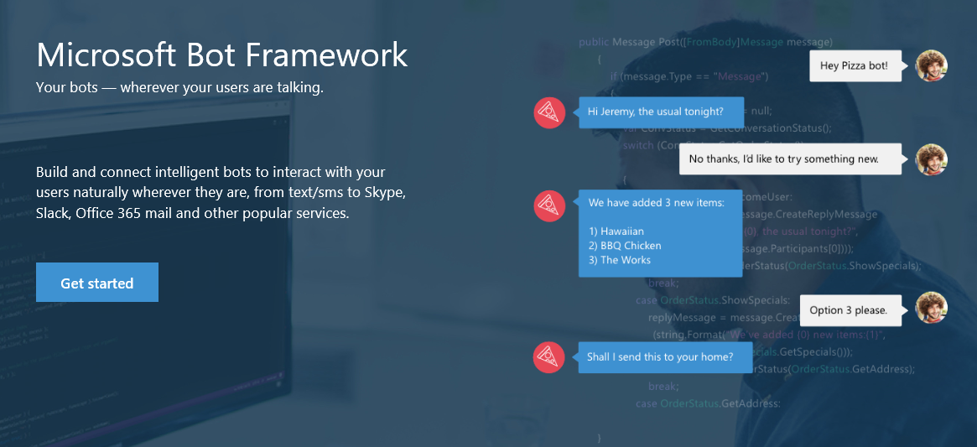
Bot Framework
https://dev.botframework.com/

Slide 5
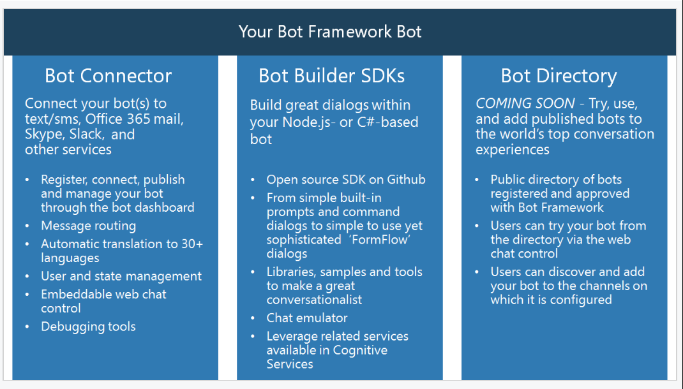
Components

Slide 6
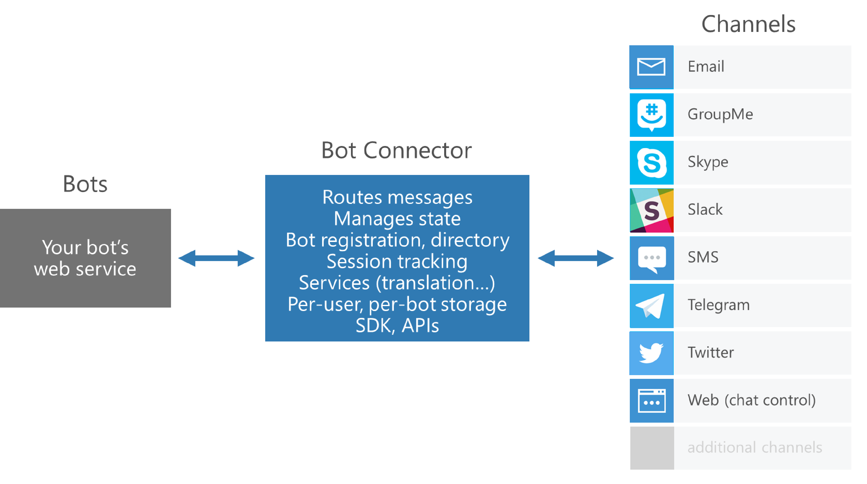
Bot Connector

Slide 7
Bot Builder SDKs
C# and Node.js
Dialogs
model a conversational process
primary channel of interaction with the outside world
dialog state is persisted in Bot Connector(per-user, per-session etc.)
Types of Dialogs
Built-in prompts
LUIS (natural language understanding)
FormFlow – building guided conversations
Profile

Slide 8
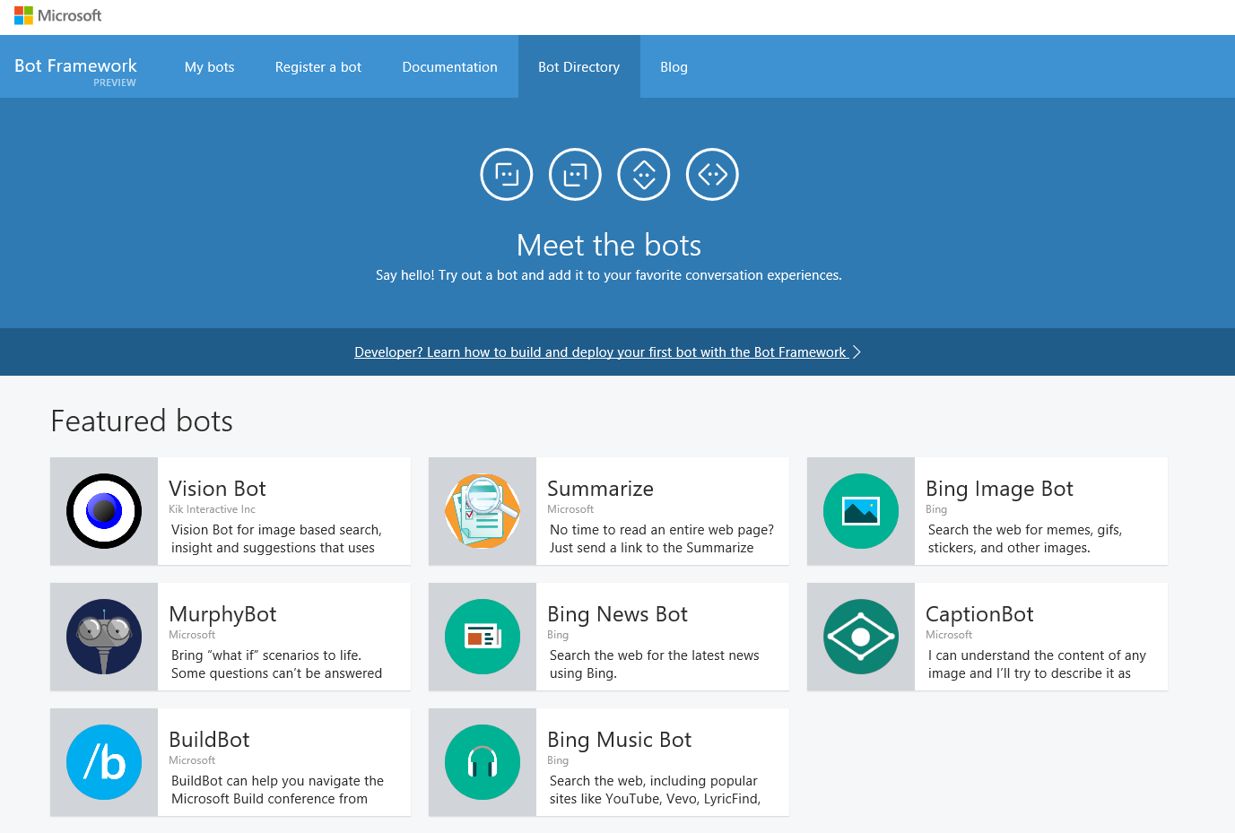
Bot Directory

Slide 9
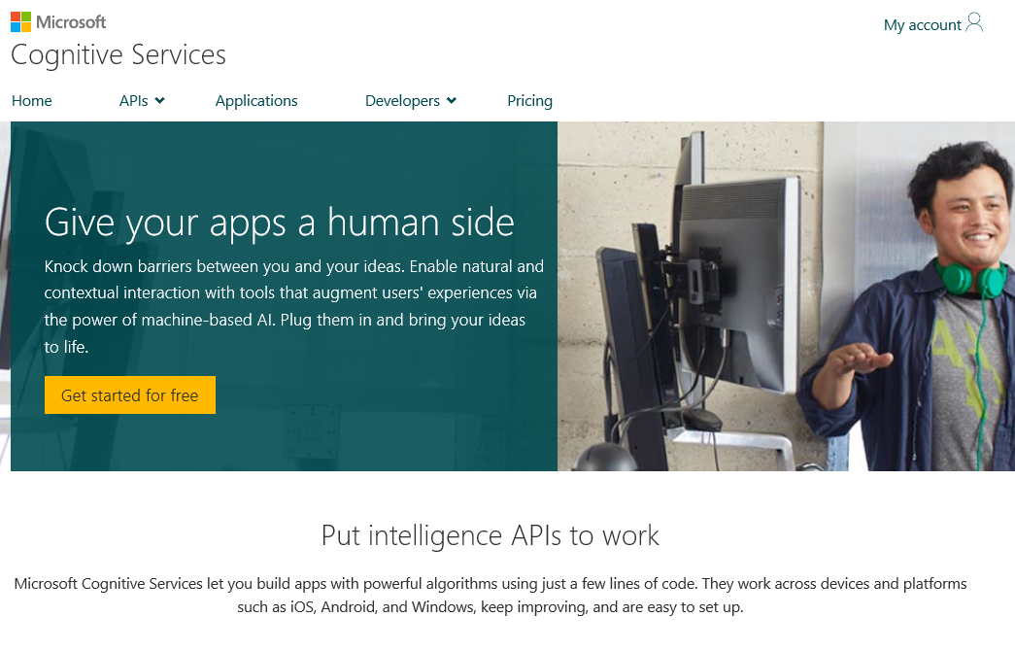
Cognitive services
https://www.microsoft.com/cognitive

Slide 10
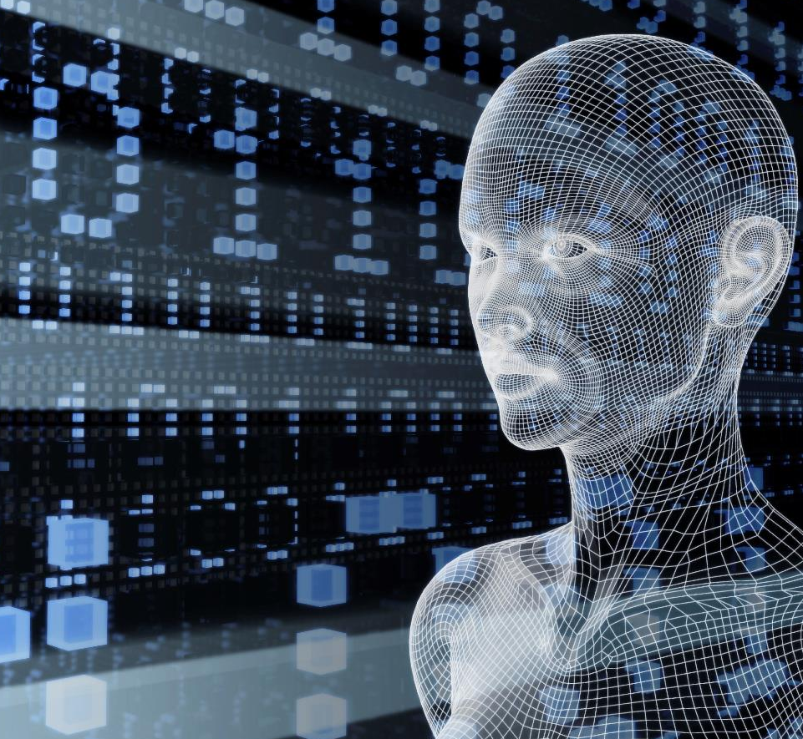
Microsoft Cognitive Services preview
Vision
From faces to feelings, allow your apps to understand images and video
Cognitive Services
Give your solutions a human side
Speech
Hear and speak to your users by filtering noise, identifying speakers, and understanding intent
Language
Process text and learn how to recognize what users want
Knowledge
Tap into rich knowledge amassed from the web, academia, or your own data
Search
Access billions of web pages, images, videos, and news with the power of Bing APIs

Slide 11
Microsoft Cognitive Services preview
Vision
Computer Vision | Emotion | Face | Video
Cognitive Services
Give your solutions a human side
Speech
Custom Recognition | Speaker Recognition Speech
Language
Bing Spell Check | Language Understanding Linguistic Analysis | Text Analytics | Web Language Model
Knowledge
Academic Knowledge | Entity Linking Knowledge Exploration | Recommendations
Search
Bing Auto Suggest | Bing Image Search | Bing News Search Bing Video Search | Bing Web Search

Slide 12
Cortana Intelligence Suite
Information Management
Big Data Stores
Machine Learning and Analytics
Intelligence
Data Sources
People
Data Factory
Data Lake Store
Machine Learning
Cognitive Services
Data Catalog
SQL Data
Warehouse
Data Lake Analytics
Bot Framework
Web
Apps
HDInsight
(Hadoop and Spark)
Event Hubs
Cortana
Mobile
Apps
Stream Analytics
Bots
Dashboards & Visualizations
Sensors and devices
Power BI
Automated Systems
Data
Intelligence
Action

